Slide 1
Orleans Roadmap
Not a 5 year plan
Virtual Meetup #8, January 21st 2016

Slide 2
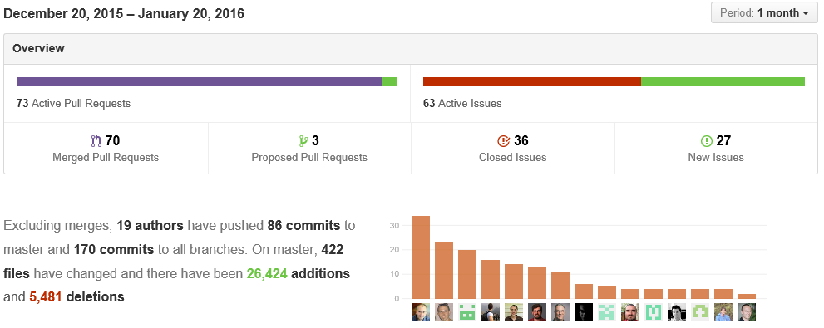
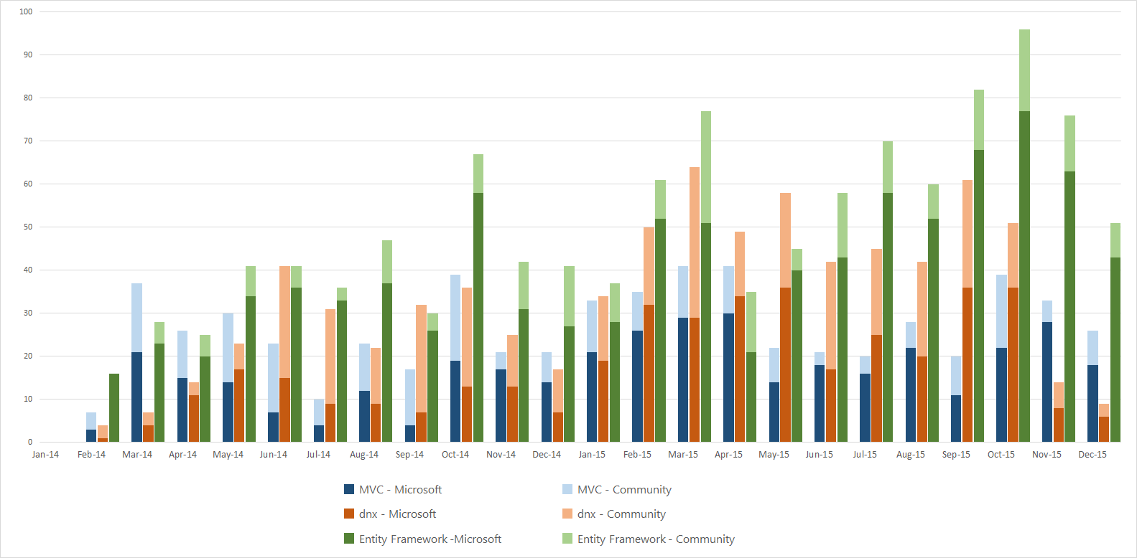
How we are doing
A typical month:
7o PRs merged
56% Community / 44% MS
For comparison:
Merged PRs in MVC/dnx/EF

Slide 3
Bigger bolder changes by community
Revamped support for SQL and MySQL
Pluggable membership storage
Codegen “heart transplant”, run time codegen
Pluggable telemetry consumers
Pluggable serializers
ASP.NET vNext DI
Elimination of GrainState
THANK YOU!

Slide 4
Orleans Tenets
Developer productivity
  Make building distributed systems qualitatively simpler
  Empower developers to focus on more interesting problems
  Less code, simpler code, proven patterns
  Time to market
Scalability by default
  Scale by orders of magnitude without major rewrites
  Avoid bottlenecks in runtime
  Prevent bottlenecks in app code
  Encapsulate proven patterns
Openness, flexibility, fast evolution

Slide 5
Uber-goals
Technology of choice for building scalable systems
  Developer productivity across diverse skill sets and problem domains
  Future-proof development via built-in scalability and openness
  Runs anywhere you need, the way you need
  Open, flexible, composable with a wide range of technologies
  Rich ecosystem of tools and extensions
  Vibrant community to tap for help, hire or to hang out with
Change the way people think about distributed apps

Slide 6
How we get there
Constant refinement and fast fixes
Stream of new features
  While avoiding cognitive overload, keeping the model simple
Themes – a set of features/changes towards a goal
Major refactoring
  Learn from usage of a feature, reimplement, redesign
Integration with other technologies
  Focus on our tenets, leverage others
Big bold bets

Slide 7
Immediate plans
1.2.0 release in 2-4 weeks, hopefully
EventHub stream adapter ported from 343i
Request interceptors (by @ReubenBond)
Everything else that’s in by then
Integration of geo-distribution code
Global single instance grains
Replicated/queued grains
Event Sourcing

Slide 8
High priority themes
CoreCLR compatibility
  Codebase
  Switching to xUnit
Deployment & cluster management
  Better Azure PaaS experience
  YAMS
  Service Fabric
  Containers
DI for application code and runtime
Persistence v2

Slide 9
Pri-2 work items (in no particular order)
Built-in web frontend for grains
Broadcast and grain groups
Documentation, samples, tutorials, project/solution templates
Non-static GrainClient to connect to multiple clusters
GrainReference vs. grain identity
Scalability of reminders
Monitoring and dashboards
Borrow back Orleankka’s features
  Programmatic config, functional composition, environments, …
Versioning and in-place upgrade
Idiomatic support for F#
Test infrastructure for one-box and distributed tests
Simplified Streaming API
Reliable grain directory

Slide 10
Aspirations
ACID cross-grain transactions
Code analysis to flag most common mistakes
Integration with JavaScript and Node.js
Integration with Java/Orbit?
3rd party networking/messaging stack, TLS
3rd party ‘magic’ serializer
Open cross-platform messaging protocol
Intelligent rebalancing of grains
Push-button deployment: local, on premises, cloud

Slide 11
What did we miss?

